Slide 1
Big Data Analysis
Spark Part 1

Slide 2
Summarization
Big data, data processing, cloud computing
  Cloud computing
  Linux/Ubuntu, command-line interface
  Hadoop HDFS
  Hadoop MapReduce
  Docker, container, docker-compose

Slide 3
Spark 01 – Introduction to Spark

Slide 4
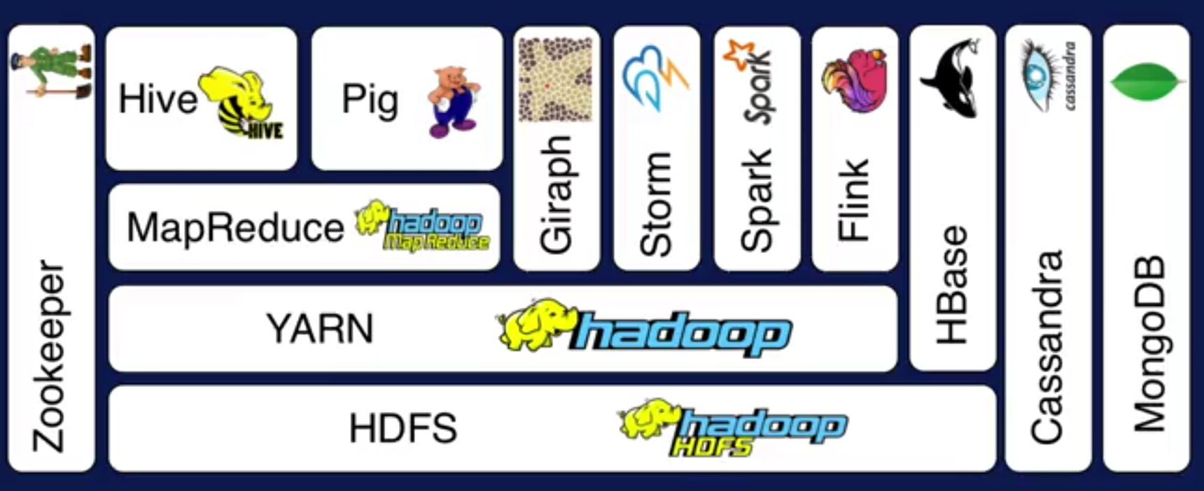
Hadoop Ecosystem

Slide 5
Lecture Objective
Understand the origins of Apache Spark
Explore the Spark API and Interface
Hands-on program to dive into Spark

Slide 6
Spark motivation
Iterative algorithms and interactive data exploration are commonly used in many domains
Traditional MapReduce and classical parallel runtimes cannot solve iterative algorithms efficiently
  Hadoop: Repeated data access to HDFS, no optimization to data caching and data transfers
  MPI(Message Passing Interface): no natural support for fault tolerance and the programming interface is complicated

Slide 7
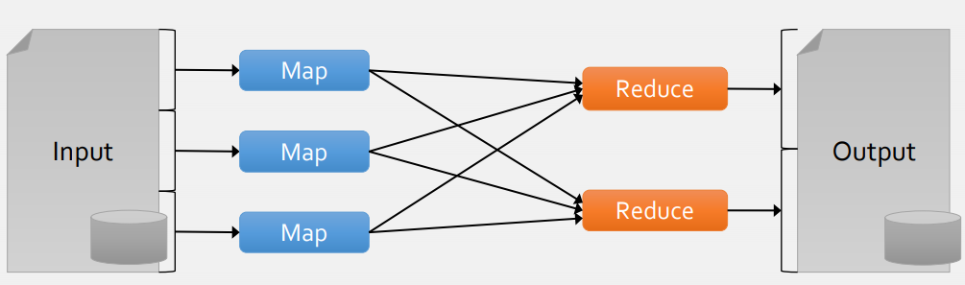
Spark motivation
The output of map tasks are saved in the local file system
The output of reduce tasks are saved in hdfs format

Slide 8
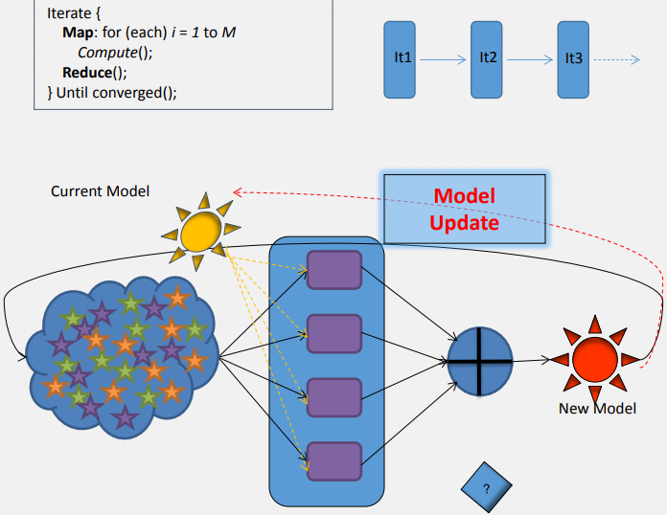
Spark motivation
Repeated reads of constant (input) data in each iteration
Run-time overheads in each iteration
Intermediate Communication resulting from model updates
Granularity of parallelism limited by iteration

Slide 9
Spark motivation
Acyclic data flow is inefficient for applications that repeatedly reuse a working set of data:
  Iterative algorithms (machine learning, graphs)
  Interactive data mining tools (R, Excel, Python)
With current frameworks, apps reload data from stable storage (hard disk) on each query

Slide 10
Spark motivation
Extend the MapReduce model to better support two common classes of analytics apps:
  Iterative algorithms (machine learning, graphs)
  Interactive data mining
Enhance programmability:
  Integrate into Scala programming language
  Allow interactive use of Scala interpreter

Slide 11
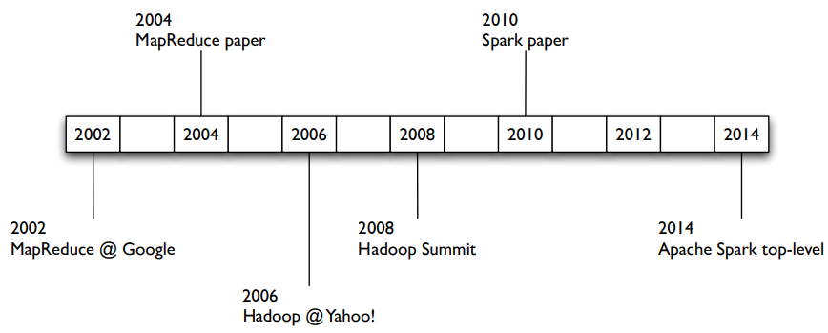
Spark history

Slide 12
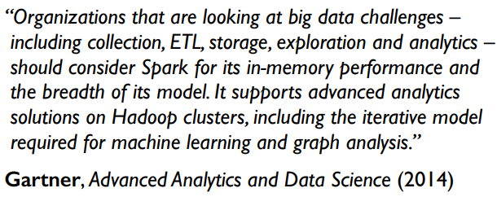

Spark history
Developed in 2009 at UC Berkeley AMP (Algorithms, Machines, and People) Lab, then open sourced in 2010, Spark has since become one of the largest OSS communities in big data, with over 200 contributors in 50+ organizations
ETL: Extract-Transform-Load

Slide 13
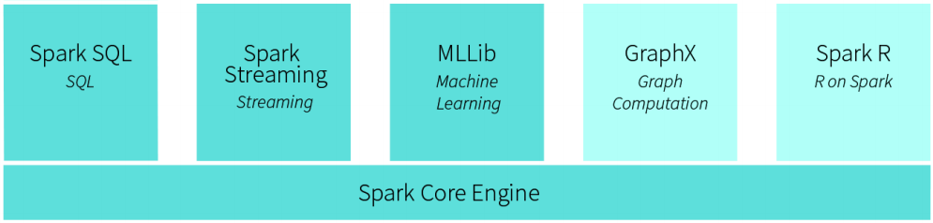
Spark Structure

Slide 14
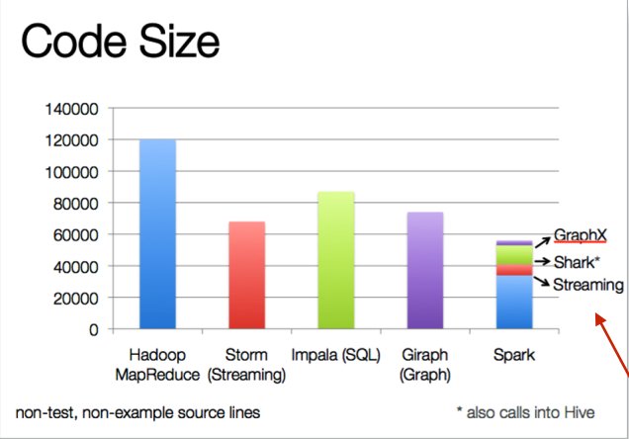
Spark Structure

Slide 15
Spark Features
Some key points about Spark:
  handles batch, interactive, and real-time within a single framework
  native integration with Java, Python, Scala
  programming at a higher level of abstraction
  more general: map/reduce is just one set of supported constructs

Slide 16
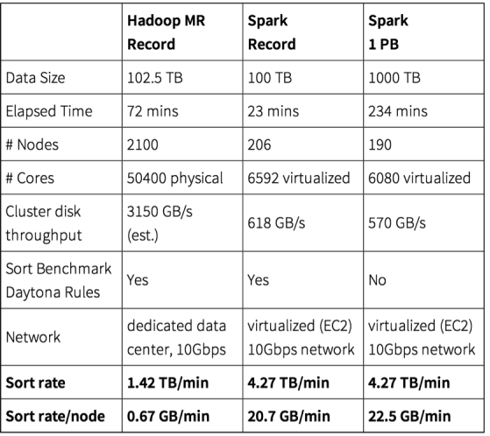
Spark Performance

Slide 17
Spark’s Main Use Cases
Streaming Data
Machine Learning
Interactive Analysis
Data Warehousing
Batch Processing
Exploratory Data Analysis
Graph Data Analysis
Spatial (GIS) Data Analysis
And many more

Slide 18
Spark in the Real World
Uber – the online taxi company gathers terabytes of event data from its mobile users every day.
  By using Kafka, Spark Streaming, and HDFS, to build a continuous ETL pipeline
  Convert raw unstructured event data into structured data as it is collected
  Uses it further for more complex analytics and optimization of operations
Pinterest – Uses a Spark ETL pipeline
  Leverages Spark Streaming to gain immediate insight into how users all over the world are engaging with Pins—in real time.
  Can make more relevant recommendations as people navigate the site
  Recommends related Pins
  Determine which products to buy, or destinations to visit

Slide 19
Spark: when not to use
Even though Spark is versatile, that doesn’t mean Spark’s in-memory capabilities are the best fit for all use cases:
  For many simple use cases Apache MapReduce might be a more appropriate choice
  Spark was not designed as a multi-user environment
  Spark users are required to know that memory they have is sufficient for a dataset
  Adding more users adds complications, since the users will have to coordinate memory usage to run code

Slide 20
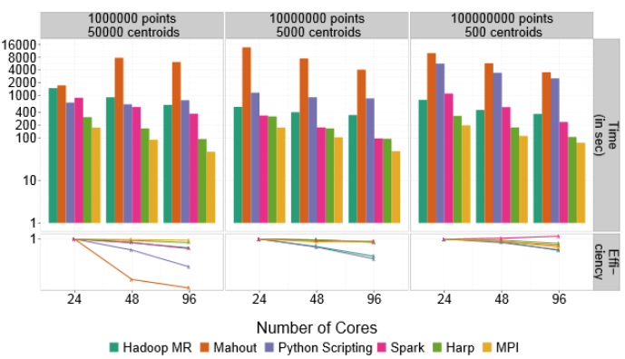
HPC and Big Data K-Means example
MPI definitely outpaces Hadoop, but can be boosted using a hybrid approach of other technologies that blend HPC and big data, including Spark and HARP. Dr. Geoffrey Fox, Indiana University. (http://arxiv.org/pdf/1403.1528.pdf)

Slide 21
Hadoop? Spark?
Hadoop (HDFS, MapReduce)
  Provides an easy solution for processing of Big Data
  Brings a paradigm shift in programming distributed system
Spark
  Has extended MapReduce for in memory computations
  for streaming, interactive, iterative and machine learning tasks

Slide 22
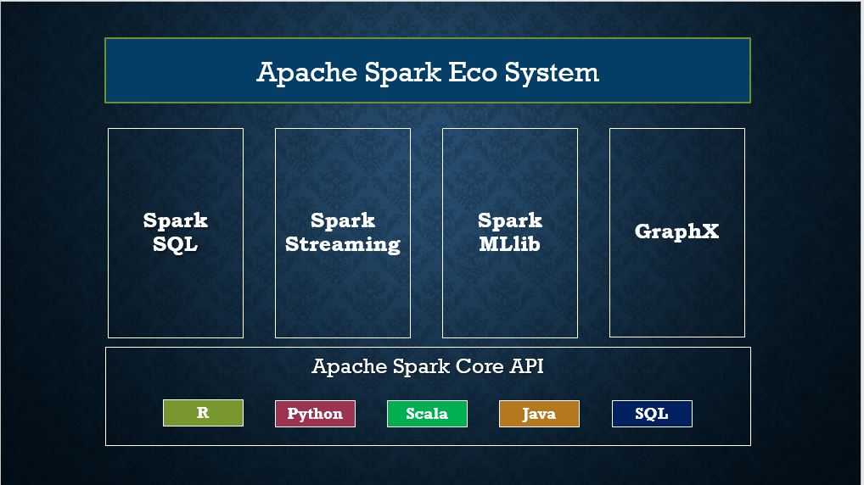
Spark Ecosystem

Slide 23
Can’t wait to try spark?
Two methods:
LOCAL Write some simple code and test on your computer
  Jupyter notebook
  PyCharm IDE
CLUSTER Setup and deploy a Spark Cluster

Slide 24
PySpark
PySpark is a Spark library written in Python to run Python application using Apache Spark capabilities, using PySpark we can run applications parallelly on the distributed cluster.
Spark basically written in Scala.
PySpark released for Python using Py4J, a Java library that is integrated within PySpark.

Slide 25
PySpark
PySpark is very well used in Data Science and Machine Learning community as there are many widely used data science libraries written in Python.
PySpark has been used by many organizations like Walmart, Trivago(www.trivago.com), Sanofi(www.sanofi.com), Runtastic(www.runtastic.com), and many more.

Slide 26
LabS01_1 - PySpark
Assuming you want to use PySpark on your laptop, and you already have anaconda and pip, then as simple as:
  > pip install pyspark –i https://pypi.tuna.tsinghua.edu.cn/simple
  or
  > conda install pyspark
You can use Jupyter Notebook for programming and testing on your laptop

Slide 27
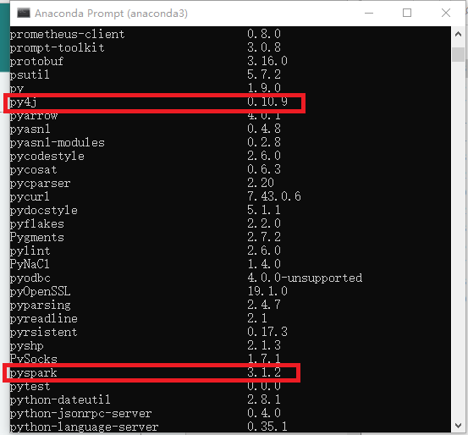
LabS01_1 - PySpark
Check your pyspark and py4j version:
> pip list
or
>conda list

Slide 28
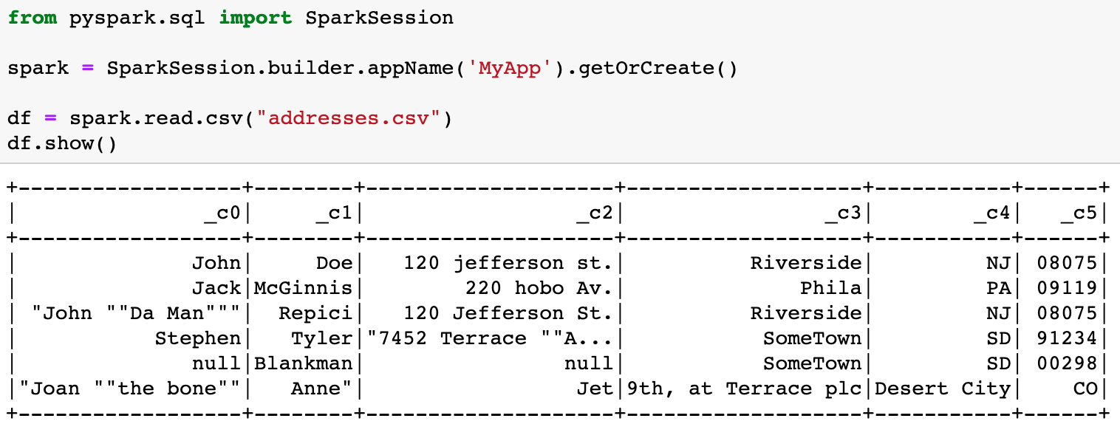
PySpark
Refer to code: LabS01_1_PySpark

Slide 29
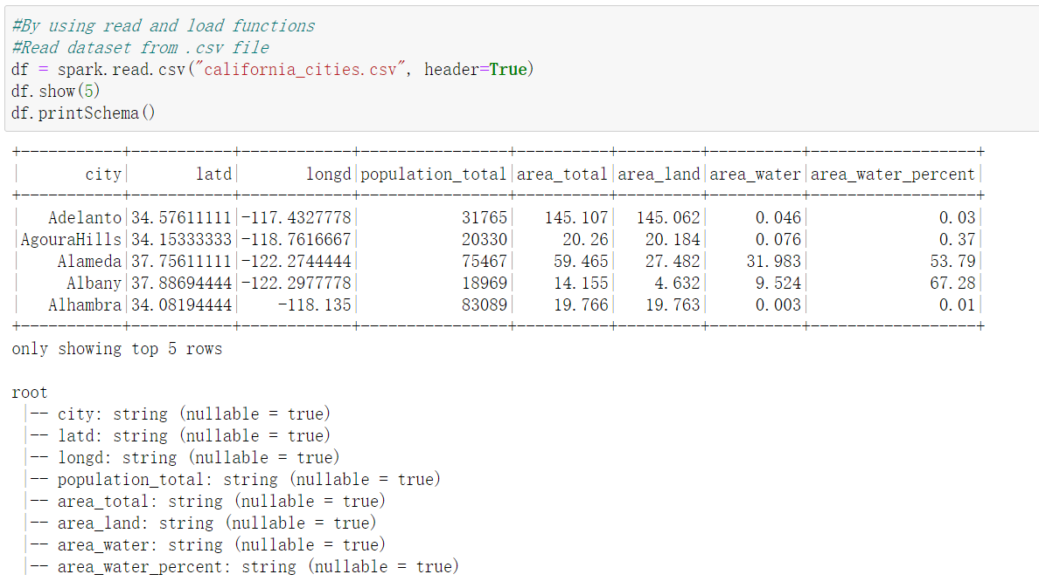
PySpark
Refer to code: LabS01_1_PySpark

Slide 30
PySpark on Docker
Alternatively, you can use the Dockerized PySpark/Jupyter container, notice every new spark context that is created is put onto an incrementing port (ie. 4040, 4041, 4042, etc.), and it might be necessary to open multiple ports.
  # docker run -d -p 8888:8888 -p 4040:4040 -p 4041:4041 -p 4042:4042 jupyter/pyspark-notebook

Slide 31
PySpark-RDD Creation
Refer to code: LabS01_2_RDD_Creation
Usually, there are two popular ways to create the RDDs:
loading an external dataset, or distributing a set of collections of objects.
1. By using parallelize( ) function
2. By using createDataFrame( ) function
3. By using read and load functions
a. Read dataset from .csv file
b. Read dataset from DataBase, for example MySQL
c. Read dataset from HDFS

Slide 32
PySpark-RDD Creation
Refer to code: LabS01_2_RDD_Creation
Data Conversion: pyspark.rdd.RDD ⬄ pyspark.sql.dataframe.DataFrame
1. RDD to DataFrame
df = rdd.toDF()
rdd = df.rdd
2. DataFrame to RDD
3. Display the content of a DataFrame
df.show()
4. Display the content of a RDD
rdd.collect()
rdd.first()
rdd.take(n)

Slide 33
Spark Cluster
Apache Spark works in a master-worker architecture where the master is called “Driver” and slaves are called “Workers”.
When you run a Spark application, Spark Driver creates a context that is an entry point to your application, and all operations (transformations and actions) are executed on worker nodes, and the resources are managed by Cluster Manager.

Slide 34
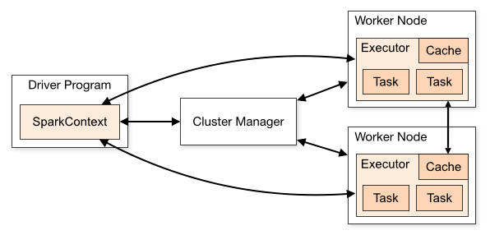
Spark Cluster

Slide 35
Spark Cluster
Need 3/4 cloud instances, e.g.
  Instance1 (Driver/Master node)
  Instance2 (Worker node 1)
  Instance3 (Worker node 2)
  Remember to turn off the firewall! (set matser and worker nodes the “securityGroup” to “ALL”)
Follow the steps of the lab file
  LabS01_3_Spark_Cluster_Setup

Slide 36
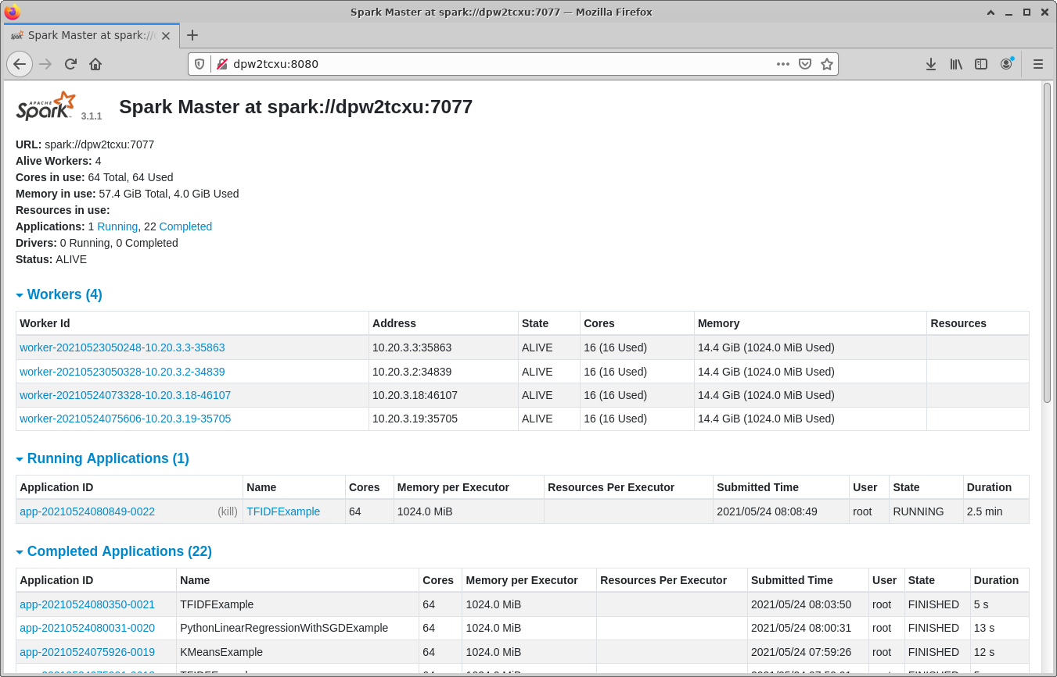
Spark Cluster
Your master node name
Monitor Spark Cluster status
  Visit the master node: e.g., dpw2tcxu:8080

Slide 37
Spark Cluster
Submit a task to the Spark Cluster
  Assuming you are now in Master directory “~/Downloads/spark-3.1.2-bin-hadoop3.2”
  Run the command on Master node:
  # spark-submit –-master spark://dpw2tcxu:7077 examples/src/main/python/pi.py
  Notice
Your master node name

Slide 38
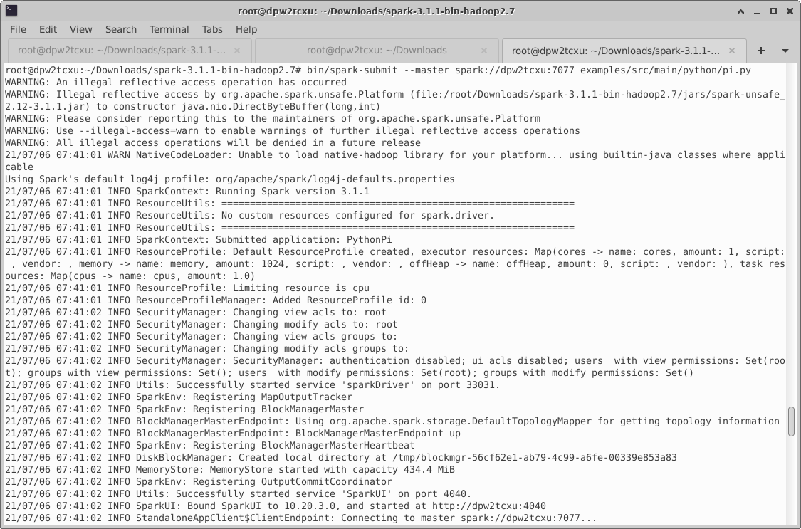
Spark Cluster

Slide 39
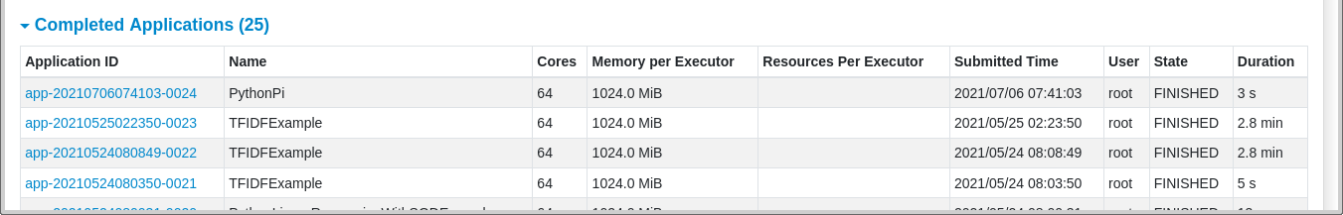
Spark Cluster
You can find the job in the “Completed Applications”

Slide 40
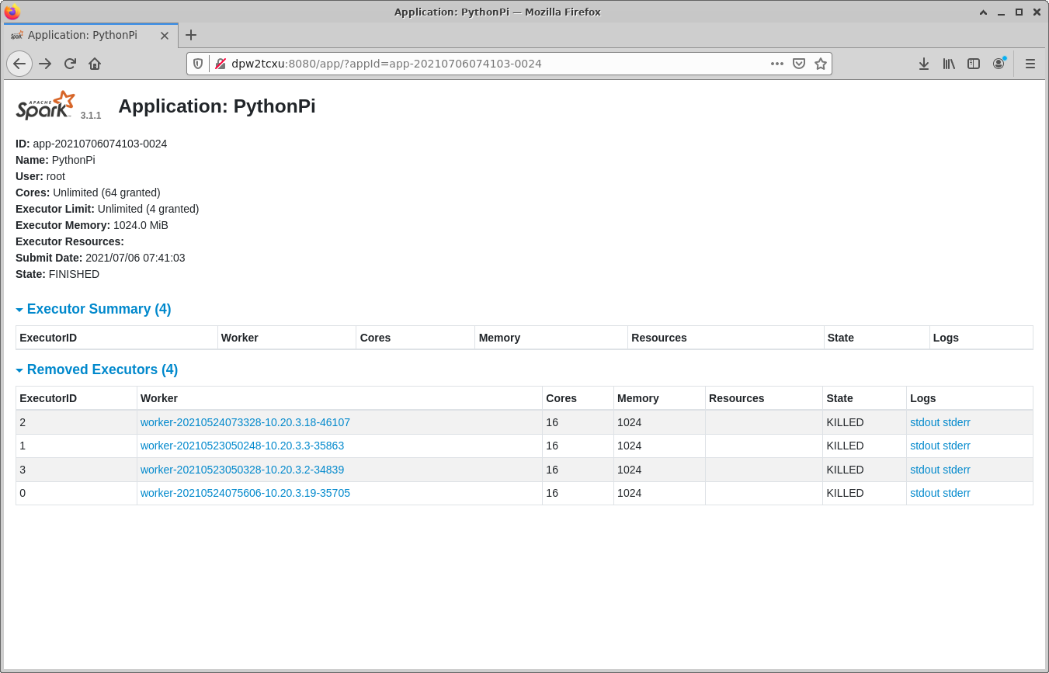
Spark Cluster

Slide 41
Appendice
Index of /anaconda/archive/ | Tsinghua Open Source Mirror
Install jupyter notebook on Tencent Cloud Ubuntu:
# pip install –upgrade
# pip install jupyter
# apt install jupyter-notebook
root user run jupyter notebook:
# jupyter-notebook --allow-root

